Slide 1

Christmas Gift
December 17, 2016

Slide 2
Agenda
Prayer and Welcome
Overview
History
What’s New
Our Needs
Important Information
Contact Details
Prayer and Closing

Slide 3
Prayer and Welcome
As we pray with thanksgiving for your participation . . . And this opportunity to minister and further the kingdom . . . may the Lord Jesus Christ our Savior lead us though this time of planning and may His direction only be sought and acknowledged.

Slide 4
Overview
Date and time of event:
  Saturday, December 17, 2016,
  8:30 AM – 3:00 PM
  Volunteer Schedules:
    Shifts available from 6AM – Midnight
    Event Setup:
      Friday, December 16, 2016
      8:00 AM - 11:00 PM

Slide 5
What’s the Purpose?
To show the love of Jesus Christ to the homeless and impoverished families.
Show special honor to our veterans.
To lead as many as possible to eternal life in heaven through Christ Jesus.
Notes:
As we move into the next phase, I have highlighted our objectives:
$4.3B in Revenues
We must not lose our momentum and sense of ACTION and URGENCY in delivering our plan. Our previous success has been hinged upon our ability to focus on our Strategy and Plan and be laser focused on these objectives
Integration
The integration can NOT become an excuse for not delivering our
Complete our Organizational Changes:
Resource actions which were difficult management decisions
- You have certainly felt these decisions as lay-off’s have
occurred in R&D (124 layoff’s)
WOW Sales (potentially 230 layoffs)
- And the most significant layoff is the Ridge Hollow, West Virginia R&D Manufacturing facility
Again, these were tough decisions and ones that were made with a great deal of discipline
Along with our 2009 strategy and plan, the integration into the systems group will . . . .

Slide 6
History

Slide 7
Christmas Gift started
13 years ago

Slide 8
Almost
125,000
Guests Served

Slide 9
Over
32,000
Volunteers
Shared the love of Jesus

Slide 10
Almost
12,500
Accepted Jesus Christ
as Lord and Savior

Slide 11
Trend of Guests Served

Slide 12
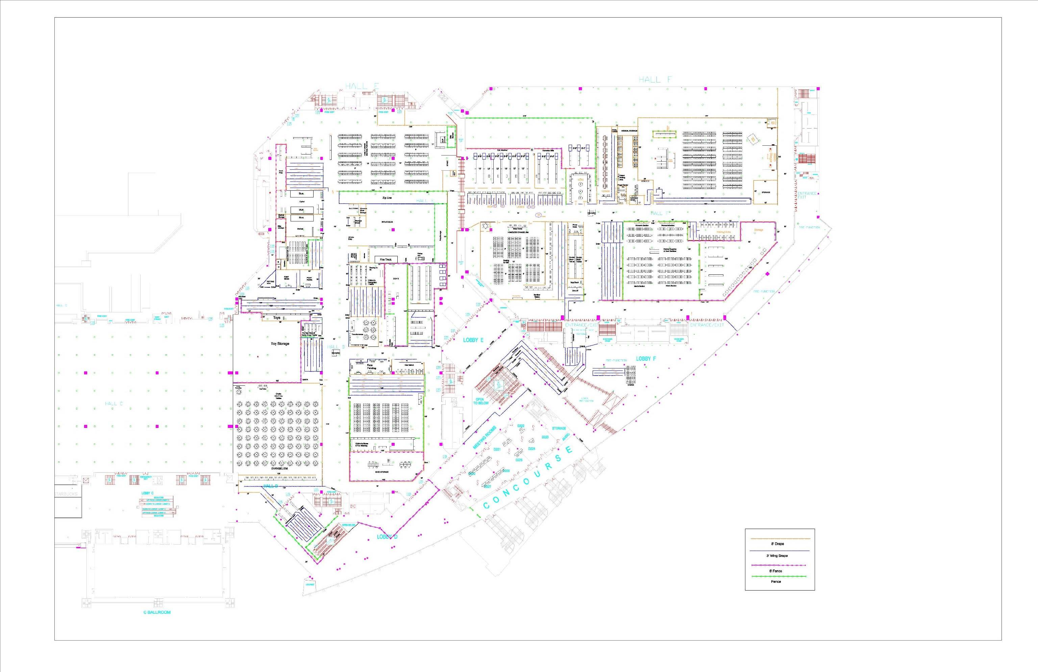

Slide 13
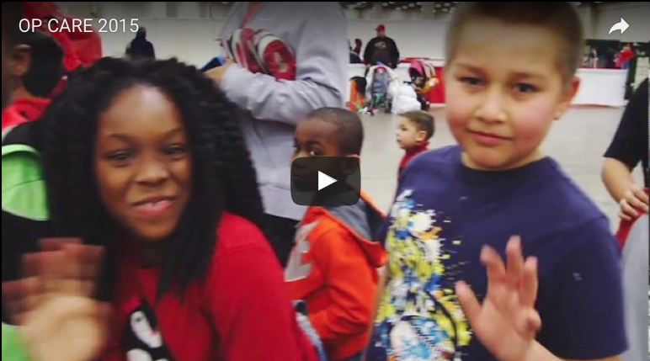
Video

Slide 14
What’s New and Improved
Outreach to South and West Dallas led by Phyllis Freeman.
A partnership with the Greater Dallas Coalition
Pre-Registration

Slide 15
What’s New and Improved:
Family Side
“We Love the Blue and the Red” area
Medical Bus for Children
Two Optical Buses for Children
Transformance: Coalition of Family Services
Information Booth for Guests and Volunteers

Slide 16
What’s New and Improved:
Family Side
Enlarged Nativity Theater
Increased Seating in Family Dining
Greatly Improved Guest Experience for Homeless Families
6 foot Security Fence Around Sensitive Areas

Slide 17
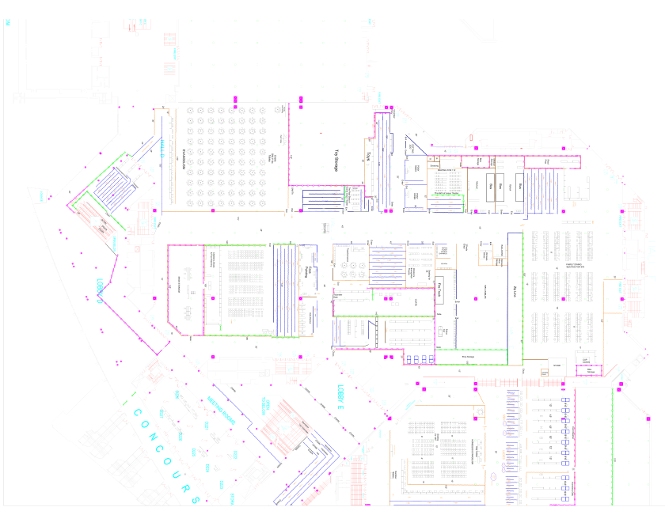
Map Impoverished Families side

Slide 18
What’s New and Improved:
Homeless Side
Turkey Dinner prepared by Mercy Chefs
A Cold Weather Gear Shop with Coats, Blankets, Sleeping Bags, and Knit Hats, Gloves, and Scarves
Homeless Gift Shop with Personal Care Products, Backpacks, and Luggage
6 foot Security Fence in Sensitive Areas
Information Booth for Guests and Volunteers

Slide 19
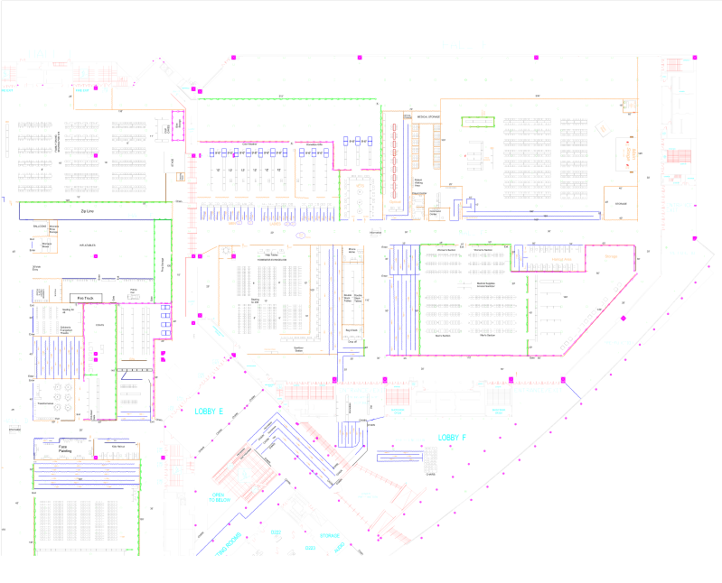
Map Homeless Side

Slide 20
What’s New and Improved:
Processes
Development of a Playbook by Project Management Team
Improved Registration Process with a Team of 100!
Wristband Redemption
Improved Queue Lines Inside and Outside

Slide 21
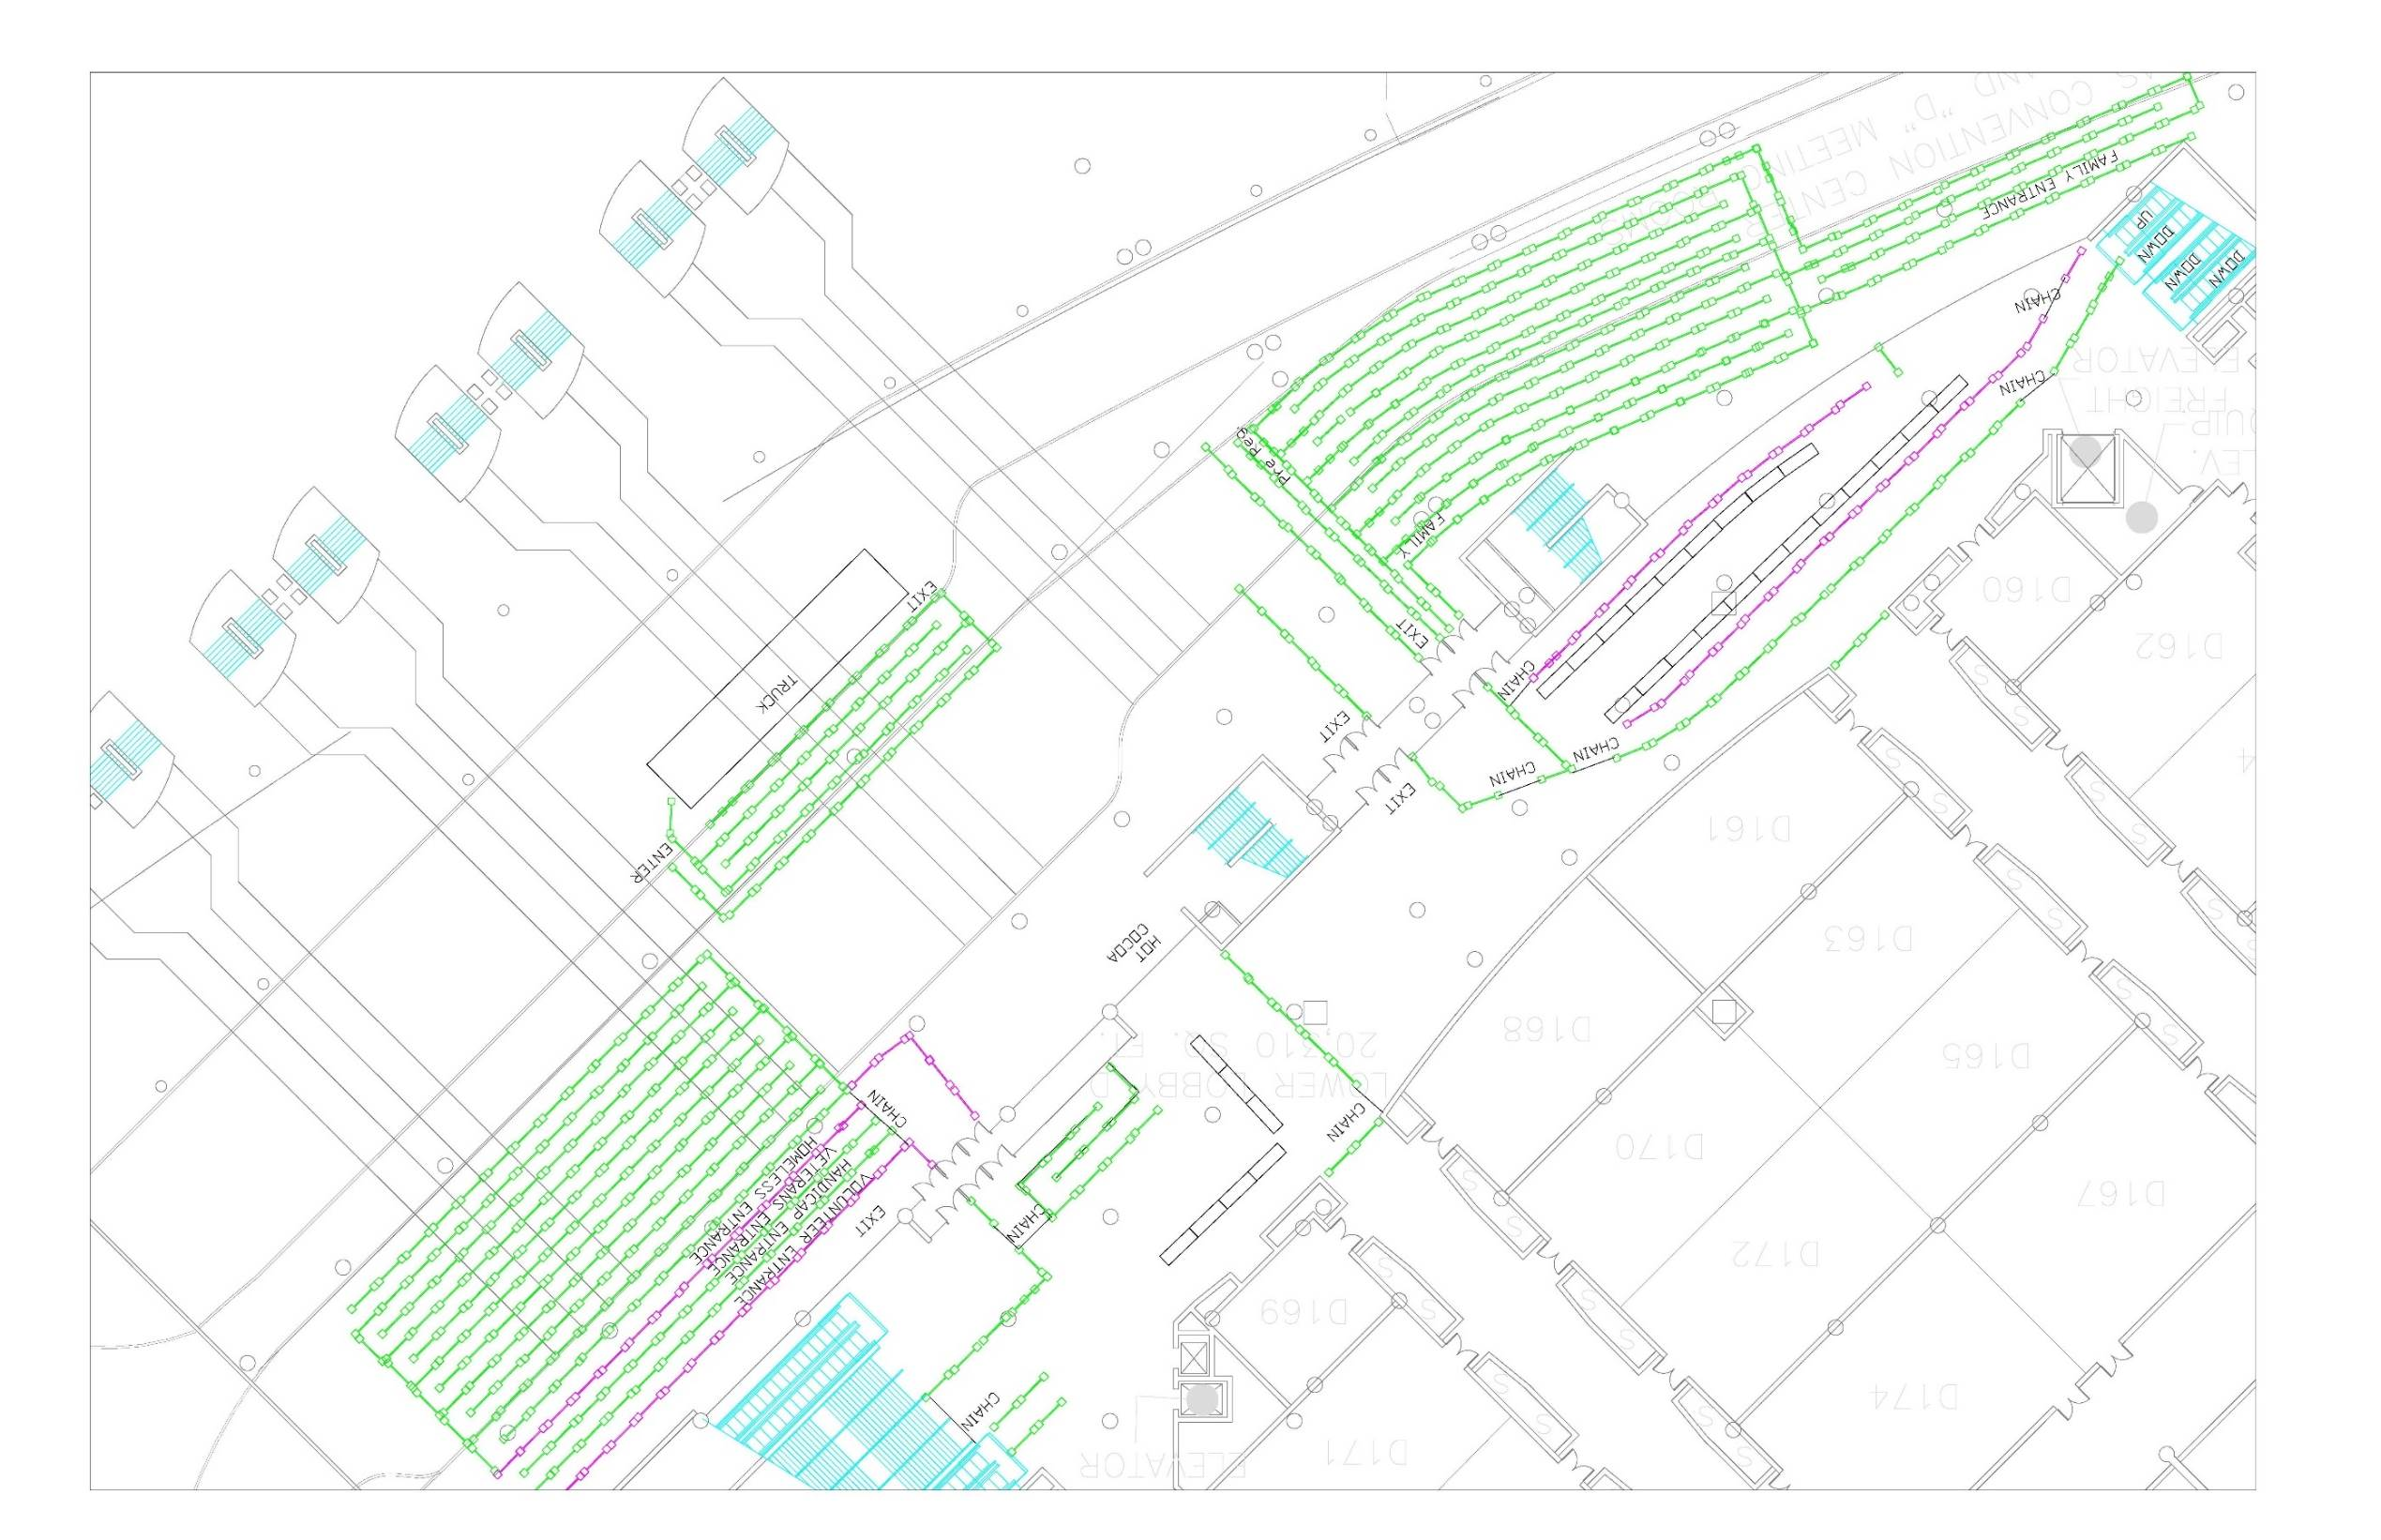

Slide 22
Our Needs: Drives

Slide 23
Why are drives so important?

Slide 24
$894,000

Slide 25
Items we need through Drives:
Homeless
Men’s coats
Ladies coats
Sleeping bags
Blankets
Men’s knit hats, gloves and scarves
Women’s knit hats, gloves and scarves
Eyeglasses
Adult rolling luggage
Adult back packs
New Adult tennis shoes
New Adult Athletic socks
New Men’s work boots

Slide 26
Quantity Needed: Homeless
6,000 Men’s Coats
1,500 Women’s Coats
1,500 Twin Size Blankets
2,000 Sleeping Bags
5,000 each: Knit Hats, Scarves and Gloves
3,000 Backpacks
2,500 Rolling Luggage Pieces
7,500 Tennis Shoes
500 Steel-toed Work Boots
1,000 Eyeglasses

Slide 27
Quantity Needed: Families
Children’s Coats – New and Gently Used
New Children’s Knit Hats, Gloves, Scarves
New Children’s Tennis Shoes
New Children’s Socks
New Children’s Backpacks
New Unwrapped Toys
New Bicycles

Slide 28
Quantity Needed: Homeless
10,000 Coats (Infant – Youth XL)
7,500 each: Knit Hats, Scarves and Gloves (All Sizes)
15,000 Toys
5,000 Backpacks
7,500 Children’s Books
10,000 Tennis Shoes

Slide 29
Drive Leader
Rusty Tillery
Rusty.tillery@gmail.com

Slide 30
Our Needs - Volunteers
Groups of volunteers for homeless
Groups of volunteers for families

Slide 31
Sponsorship Groups Needed
10 Key Areas for Group Volunteer Opportunities
Homeless
Evangelism
  20 groups of 25
  10 groups of 50
Cold Weather Gear
  Two groups of 72
Gift Shop of Blessings
  Two groups of 36
Shoes
  Two groups of 75
www.operationcareinternational.org

Slide 32
Sponsorship Groups Needed
10 Key Areas for Group Volunteer Opportunities
Impoverished Families
Evangelism
  20 groups of 25
  10 groups of 50
Children’s Cold Weather Gear
  Two groups of 50
Children’s Shoes
  Soles for Kidz
Children’s Toys
  Two groups of 100
Homeless Families Gift Shop
  Two groups of 75

Slide 33
Sponsorship Groups Needed
9 Key Areas for Group Volunteer Opportunities
Homeless
Impoverished Families
16 groups
totaling 866 volunteers
16 groups
Totaling 950 volunteers
www.operationcareinternational.org

Slide 34
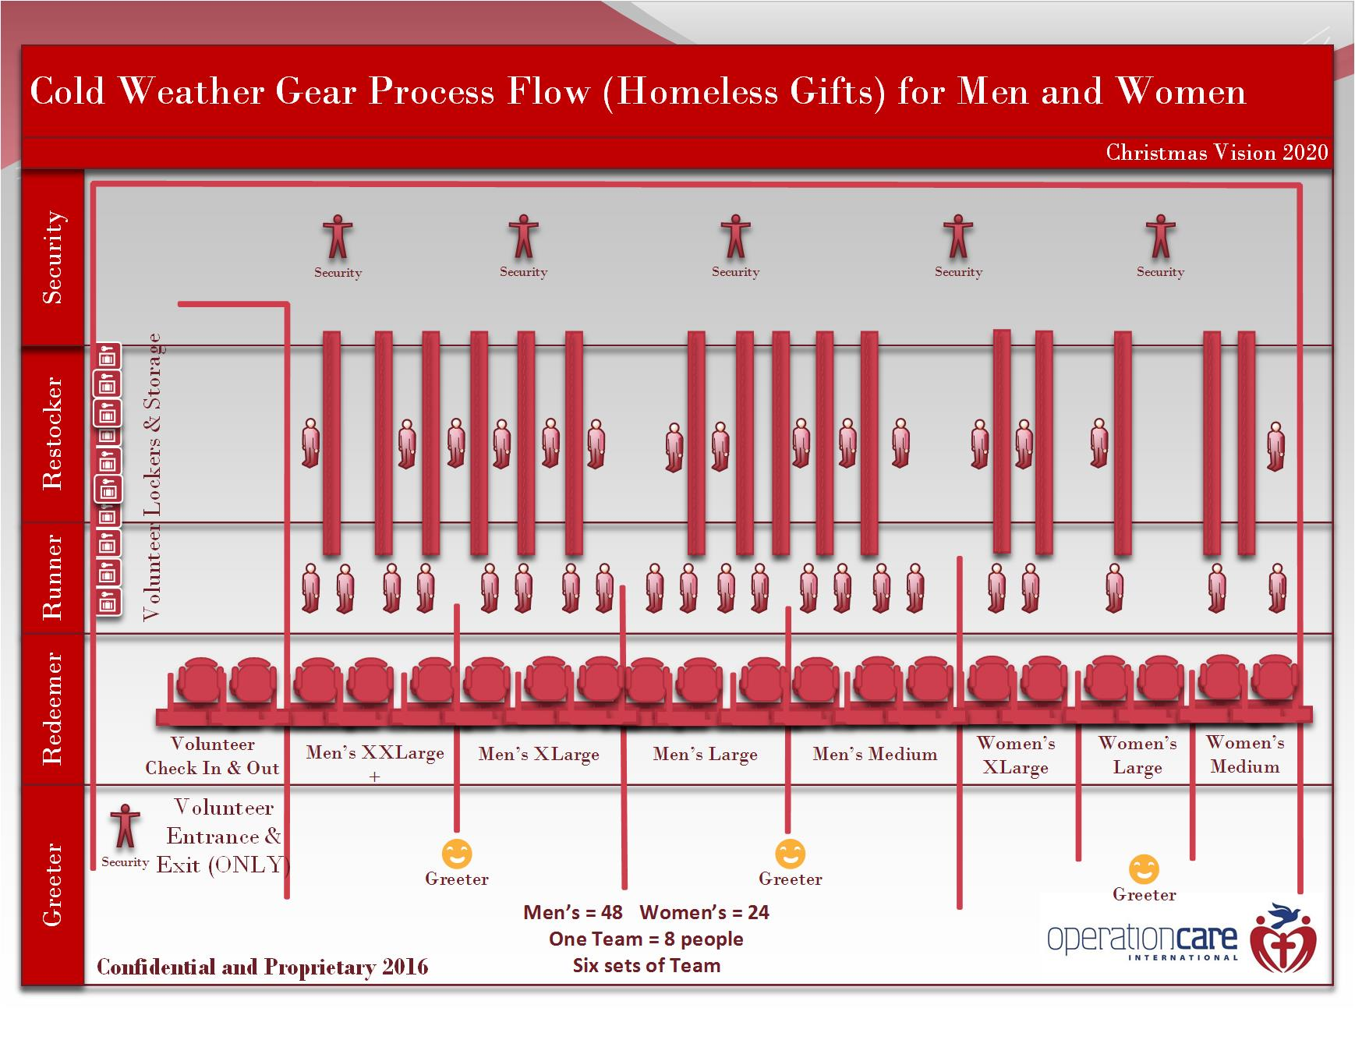
Cold Weather Gear Shop
Cold Weather Gear Diagram

Slide 35
Group Volunteer Coordinator
Ron Batts
ronaldbatts@sbcglobal.net
Cell: 214-534-4602

Slide 36
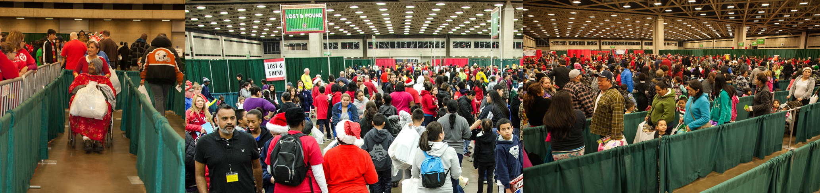
Our Needs - Financial
2015
2016
estimated costs
$258,327
$275,244
www.operationcareinternational.org

Slide 37
Our Needs - Financial
Still need $150,000

Slide 38
Fundraising: Classy
New Peer to Peer Fundraising Tool
National Average: Every Organizer Will Involve 10 Peers and Raise $500
Especially Powerful for Millennials
We Need Help with Millennial Church Outreach
www.operationcareinternational.org

Slide 39
Classy Coordinator
Chris Butler
cbutler@criswell.edu
(325)262-7076

Slide 40

31 Days of Mountaintop Miracles
Wonderful Christmas Gift
Signed by Susie
Only $20
All Proceeds go to Operation Care
www.operationcareinternational.org

Slide 41
Important Information
All volunteers are required to wear red t-shirt
Official OCI T-shirts are available for sale for $10
Official OCI hats are available for sale for $10
All sale proceeds go directly to OCI
Volunteer registration
www.operationcareinternational.org

Slide 42
Fundraising: Love Offering
A Love Gift of $10 or More per Volunteer Will be Greatly Appreciated.
Donation Boxes are Located:
Volunteer Registration
We will “pass the plate” at Opening Ceremonies (7:30 Homeless and 8:00 Families)
www.operationcareinternational.org

Slide 43
Fundraising: Speaking Engagements
To Schedule Susie, Ron or Another Board Member to Make a Presentation to Your Church or Organization, Contact The Operation Care Office at: susiejopcare@sbcglobal.net or (972)681-3567.
www.operationcareinternational.org

Slide 44
Our Needs: Prayer
Starting Monday, November 14th,Check Operation Care Website (opcare.org) daily for Our Prayer Calendar.

Slide 45
Do’s and Don’t
Don’t bring purse
Don’t leave your coat unattended
Don’t bring children under 12 years of age
Don’t give money to our guests
Don’t let our guests use your cell phone

Slide 46
Do’s and Don’t
Do be a little early for your shift to allow time for parking and navigating through the crowds
Do wear comfortable shoes
Do purchase and official Operation Care red t-shirt or wear one of your own
Do be prepared to be blessed
Do prayerfully consider bringing a love gift of $10 or more to help bless our guests

Slide 47
Parking
Parking is $15.00
We highly recommend you take the DART train to save time and money
Convention Center Garage opens at 6am
Lot E is reserved for registered large groups of volunteers and will be free for them, as well as parking for buses

Slide 48
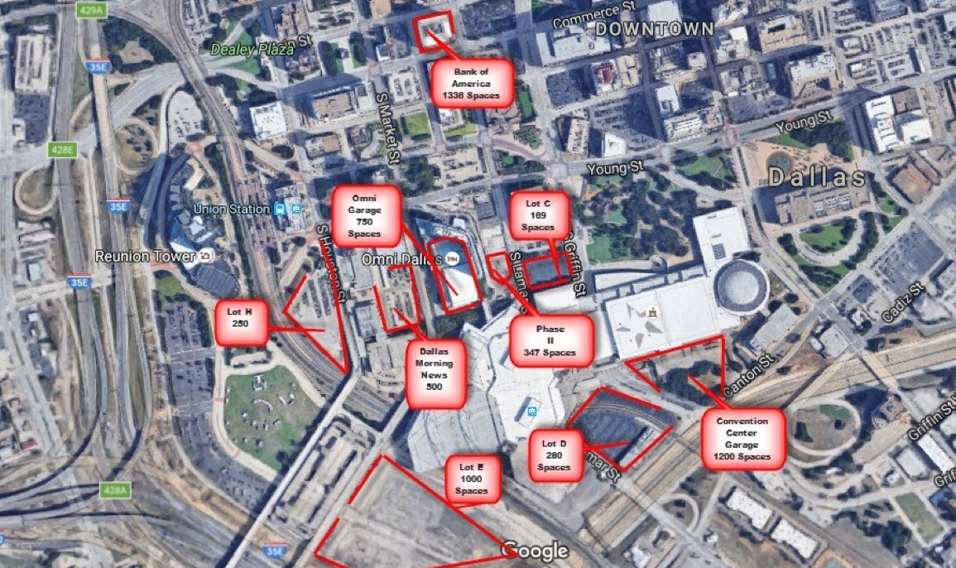
Available Parking

Slide 49
Contact Information
Website www.opcare.org
Hotline for Operation Care 972-681-3567
Donations please bring to: EXL Exchange Logistics
3113 Glenfield Ave., Dallas, TX 75233
or
Consult our website for drop-off locations
Rusty Tillery Ron Batts Chris Butler
Rusty.tillery@gmail.com ronaldbatts@sbcglobal.net cbutler@criswell.edu
Drive Leader Group Volunteer Leader Classy Coordinator

Slide 50
Prayer and Closing
Thank You for your Commitment, Dedication, and Support of Operation Care Christmas Gift 2016. Please help us make this the best birthday party for Jesus.
Always be kind to everyone, you just don’t know the battle they are fighting at that very moment!
Remember JESUS is the reason for the season!
He who has pity upon the poor lends to the Lord.
Proverbs 19:17

